Slide 1
INFO 4602/5602 Information Visualization
Individual Project Presentation
Dashboard on Healthcare Data by ONYX
Student Name: Rohith Peddi

Slide 2
Table of Contents
Context/environment
Motivation for dashboard
3 key research questions
(Real-world) data source and discussion
Presentation and discussion of individual dashboard charts
Presentation and discussion of dashboard
Answers to 3 key research questions and any recommendations
URL/ web link for online

Slide 3
Context
The healthcare industry is increasingly data-driven, aiming to optimize patient care while controlling costs.
Hospitals generate large volumes of patient data covering admissions, diagnoses, costs, and outcomes.
Analyzing these data points helps identify operational inefficiencies and opportunities to improve care quality.
This dashboard is designed to support hospital administrators, healthcare analysts, and policymakers by offering a comprehensive view into hospital operations, patient outcomes, and cost-related patterns.

Slide 4
Motivation
Healthcare systems need clarity on how different variables—like admission types, conditions, and insurance providers—affect patient outcomes and costs. This dashboard aims to:
Improve decision-making with clear visual insights.
Identify which conditions or admission types lead to longer hospital stays or higher costs.
Assess hospital and insurer performance.
Highlight patient outcome disparities.

Slide 5
3 key research questions
What are the most common age groups, genders, and blood types among patients? Are certain groups being admitted more often than others?
Which medical conditions are diagnosed the most, and do they affect certain groups of people more than others?
How are patients admitted - mostly through emergency, urgent, or planned admissions - and how does that impact the length of stay or treatment costs?

Slide 6
(Real-world) data source and discussion
The data is sourced from ONYX Data DNA – Dataset challenge(source) which contains real world hospital data with details around,
Patient demographics (age, gender, blood type)
Diagnosis (condition)
Admission type (Emergency, Urgent, Planned)
Hospital information
Insurance provider
Length of stay
Cost of treatment
Outcome metrics (e.g., test results)

Slide 7
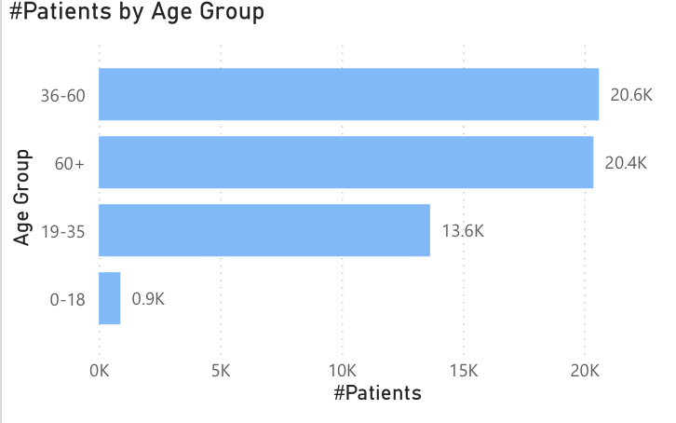
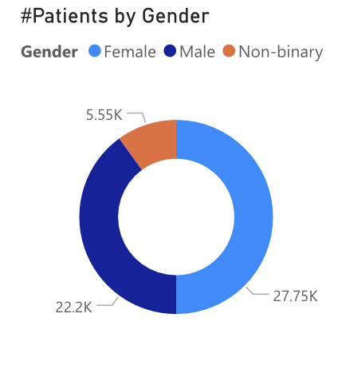
Presentation and discussion of individual dashboard charts

Slide 8
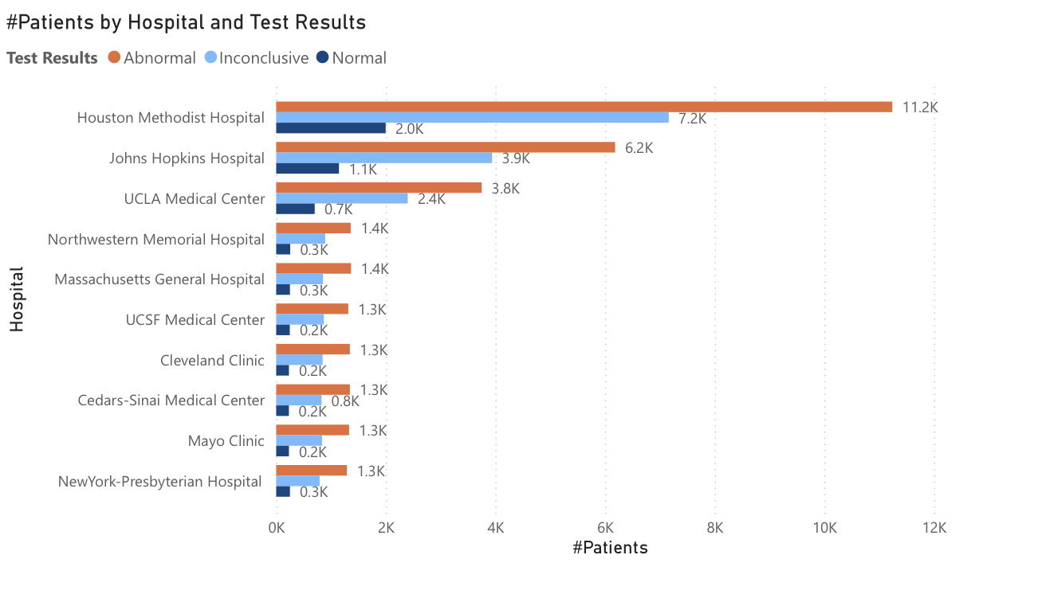
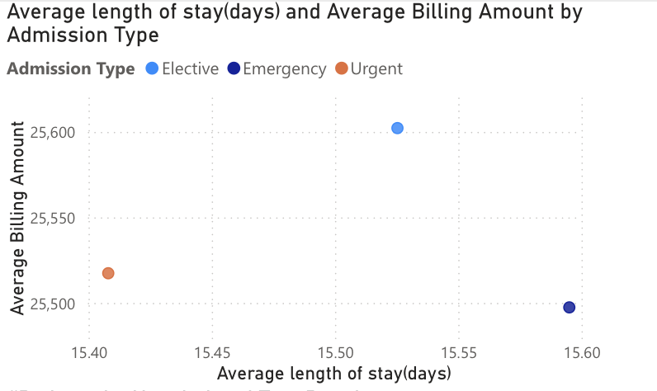
Presentation and discussion of dashboard

Slide 9


Microsoft Power BI

Slide 10
Answers to 3 key research questions
Most common age groups – 36-60 years, Gender– Female, Blood Type – A+
Diabetes and Hypertension is diagnosed more, patients with O+ and A+ tend to diagnose with these conditions and often in females.
Cost is almost same for all the outcomes with a minor changes, same with stay.

Slide 11
